Slide 1
HR DATA - EXPLORATORY DATA ANALYSIS USING PYTHON

Slide 2
About HR
HR analytics provides data-backed insights to make objective and informed choices regarding recruitment, training, compensation, and workforce management.
HR analytics can track employee performance metrics (e.g., sales targets, project completion rates) and identify areas for improvement. This allows for targeted training, coaching, and performance management programs.
Analyzing trends in skills, demographics, and employee turnover helps HR anticipate future workforce needs. This enables proactive talent acquisition strategies and development programs to address potential skill gaps.
By analyzing employee survey data and feedback, HR can identify factors influencing employee morale and satisfaction. This allows for initiatives to improve workplace culture, address concerns, and enhance employee engagement, leading to increased productivity.
This analysis will help organizations develop strategies to reduce turnover, leading to better employee retention, increased productivity, and overall business success.

Slide 3
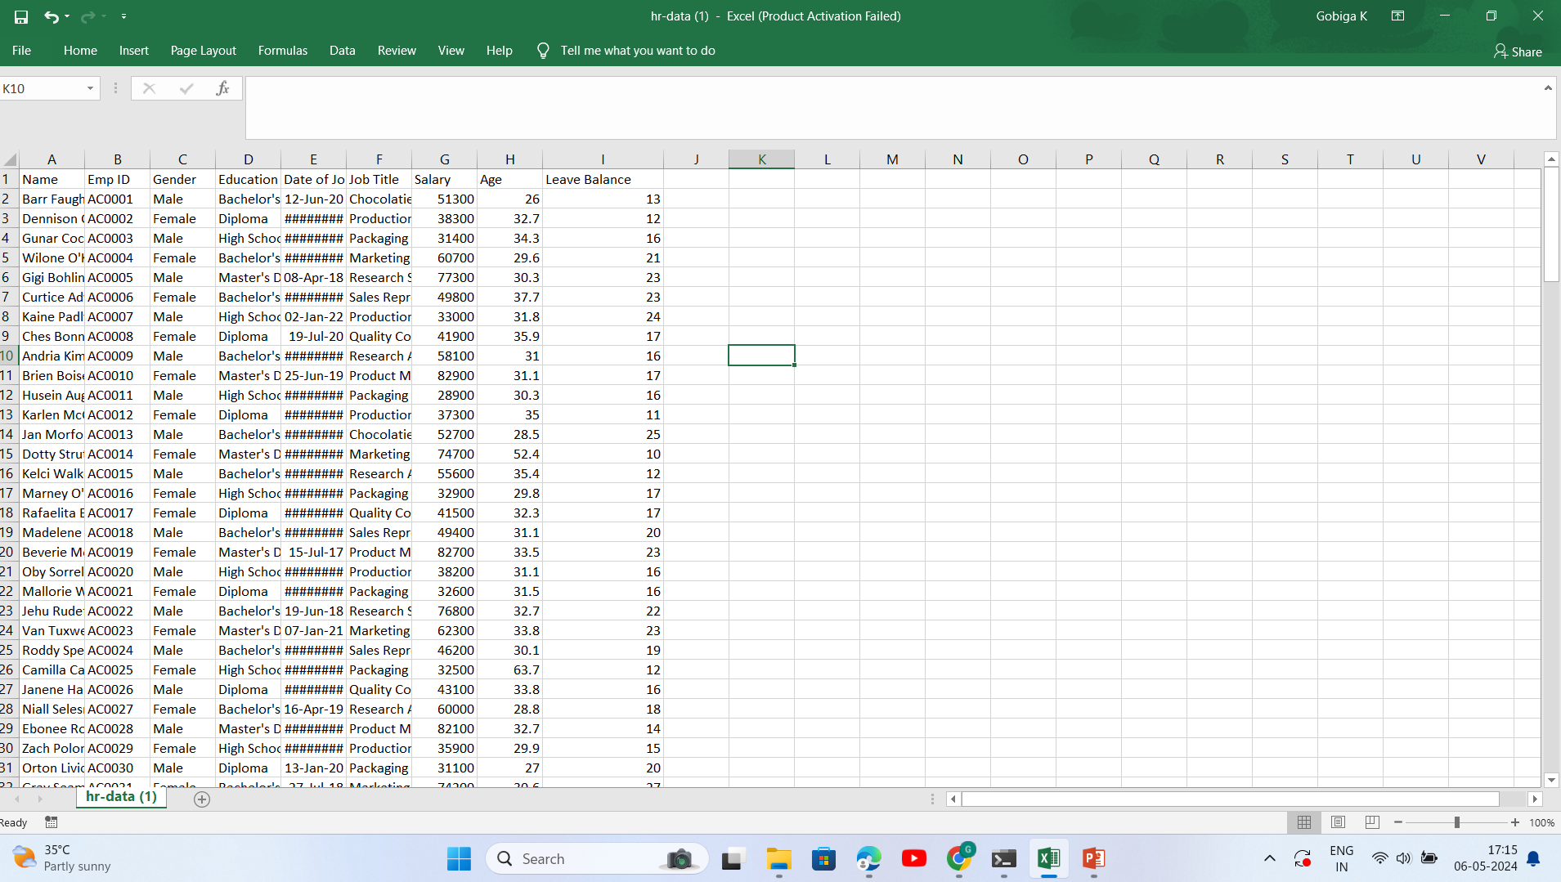
Given dataset

Slide 4
Observations
Educational Background and Gender Distribution:
Focus on Diplomas and High School Diplomas: Attract more female candidates with targeted campaigns for roles like Packaging Associate.
Tailored Strategies for Bachelor's and Master's Degrees: Develop separate recruitment strategies for Bachelor's degrees (suitable for most roles) and Master's degrees (often preferred for managerial positions).
2. Skills and Role Preferences:
Closing the Gender Gap in Marketing: Investigate reasons behind lower female representation in Marketing roles and develop initiatives to attract and retain female talent in Marketing Specialist positions.
Identifying High-Demand Roles: Focus recruitment efforts on roles with high female preference, like Packaging Associate and Research Scientist.

Slide 5
Observations
3. Educational Background and Job Requirements:
Upskilling for Diploma Holders: Offer training programs to bridge skill gaps for Diploma holders who are excluded from certain roles (e.g., Chocolatier, Marketing Specialist).
Managerial Roles and Education: Ensure educational requirements for managerial positions are clearly defined and consider experience alongside academic qualifications.
4. Education, Salary, and Job Level:
Revise Compensation Structure: Investigate the pay gap between Bachelor's and Master's degrees and consider adjusting compensation based on experience and performance rather than solely on highest academic qualification.

Slide 6
Observations
5. Age Distribution and Leave Balance:
Focus on Employee Retention: Target employee engagement initiatives towards the 30-35 age group, which has the highest population, to improve retention rates.
6. Demand Fluctuations by Role and Year:
Strategic Workforce Planning: Analyze trends in role demand (e.g., decline in recruitment since 2020) and adjust workforce planning accordingly.
Targeted Recruitment Efforts: Identify roles with consistent demand (e.g., Packaging Associate) and focus recruitment efforts to maintain staffing levels.
7. Experience and Job Requirements:
Optimizing Hiring Criteria: Consider revising experience requirements for roles like Packaging Associate (which can accept less experienced candidates) while maintaining high standards for positions like Product Manager (which require more experience).

Slide 7
Thank you..!!

